Slide 1


Michael Ames amesam@wfu.edu
Wake Forest
School of Business
_______
Boosting

Slide 2
Lets review
Business Rules
Can be driven by data BUT not super effective because requires lots of very specific conditions
Decision Trees
Effective at prediction BUT very sensitive to data and inputs, tend to overfit
Random Forest (Bagging)
Very effective, avoids overfitting
Random Forest/Bagging is a simple ensembling technique in which we build many independent predictors/models/learners and combine them using some model averaging techniques. (e.g. weighted average, majority vote or normal average)
It is effective because, we take a random sub-sample/bootstrap of data for each model, so that all the models are little different from each other AND each observation is chosen with replacement to be used as input for each of the model. So, each model will have different observations based on the bootstrap process.

Slide 3
Boosting
Boosting is an ensemble technique in which the predictors are not made independently, but sequentially.
Essentially subsequent predictors learn from the mistakes of the previous predictors.

Slide 4
Boosting
We first model data with simple models and analyze data for errors.
These errors signify data points that are difficult to fit by a simple model.
Then for subsequent models, we focus on those hard to fit data to get them right.
Combine all the predictors by giving some weights to each predictor.
Trevor Hastie in all his Glory!
https://www.youtube.com/watch?v=wPqtzj5VZus
https://www.youtube.com/watch?time_continue=215&v=sRktKszFmSk&feature=emb_logo

Slide 5
Boosting
Key components
Number of Trees
Constrains the algorithm, it learns sequentially
Tree Constraints (our standard set)
Tree depth, deeper trees are more complex trees and shorter trees are preferred. Generally, better results are seen with 4-8 levels.
Number of nodes or number of leaves, like depth, this can constrain the size of the tree, but is not constrained to a symmetrical structure if other constraints are used.
Number of observations per split imposes a minimum constraint on the amount of training data at a training node before a split can be considered
Weighted Updates
The predictions of each tree are added together sequentially. The contribution of each tree to this sum can be weighted to slow down the learning by the algorithm. This weighting is called a shrinkage or a learning rate.
Stochastic Gradient Boosting
At each iteration a subsample of the training data is drawn at random (without replacement) from the full training dataset. The randomly selected subsample is then used, instead of the full sample, to fit the base learner.
Subsample rows and columns before creating each tree.
Subsample columns before considering each split.

Slide 6
Boosting

Slide 7
Boosting
Sklearn’s GBM
learning_rate=0.1 (shrinkage) - the learning rate shrinks the contribution of each tree by learning_rate. There is a trade-off between learning_rate and n_estimators.
n_estimators=100 (number of trees)
Standard Tree Parameters:
max_depth = 3, notice with GBM we use Stumpy trees
min_samples_split = 2
min_samples_leaf = 1
subsample=1.0 - The fraction of samples to be used for fitting the individual base learners. If smaller than 1.0 this results in Stochastic Gradient Boosting. Compare a larger and smaller values

Slide 8
GBM (pipeline example)
from sklearn.ensemble import GradientBoostingClassifier
categorical_pipe = Pipeline([
('imputer', SimpleImputer(strategy='constant', fill_value='missing')),
('trgenc', TargetEncoder(smoothing = 2)) ])
numerical_pipe = Pipeline([
('imputer', SimpleImputer(strategy='mean'))])
preprocessing = ColumnTransformer(transformers=[
('cat', categorical_pipe, categorical_features),
('num', numerical_pipe, numeric_features)])
model_pipeline = Pipeline([
('preprocess', preprocessing),
('classifier', GradientBoostingClassifier())
])

Slide 9
How do I,
improve my model’s performance?
Do nothing, the defaults are good enough
Starting point, it’s simple but leaves a lot of performance on the table.
Change Hyperparameters by Hand
Good for fine tuning, not good for finding good starting point
Time consuming
Brute force grid search - try all possible combination of the set of Hyperparameters from searchable space
Good for finding a “good” model
Time consuming
Random grid search - randomly choose combinations of hyperparameters from searchable space
Good for finding a “good enough” model, may find a better model because of noise
Less time consuming fewer searches.

Slide 10
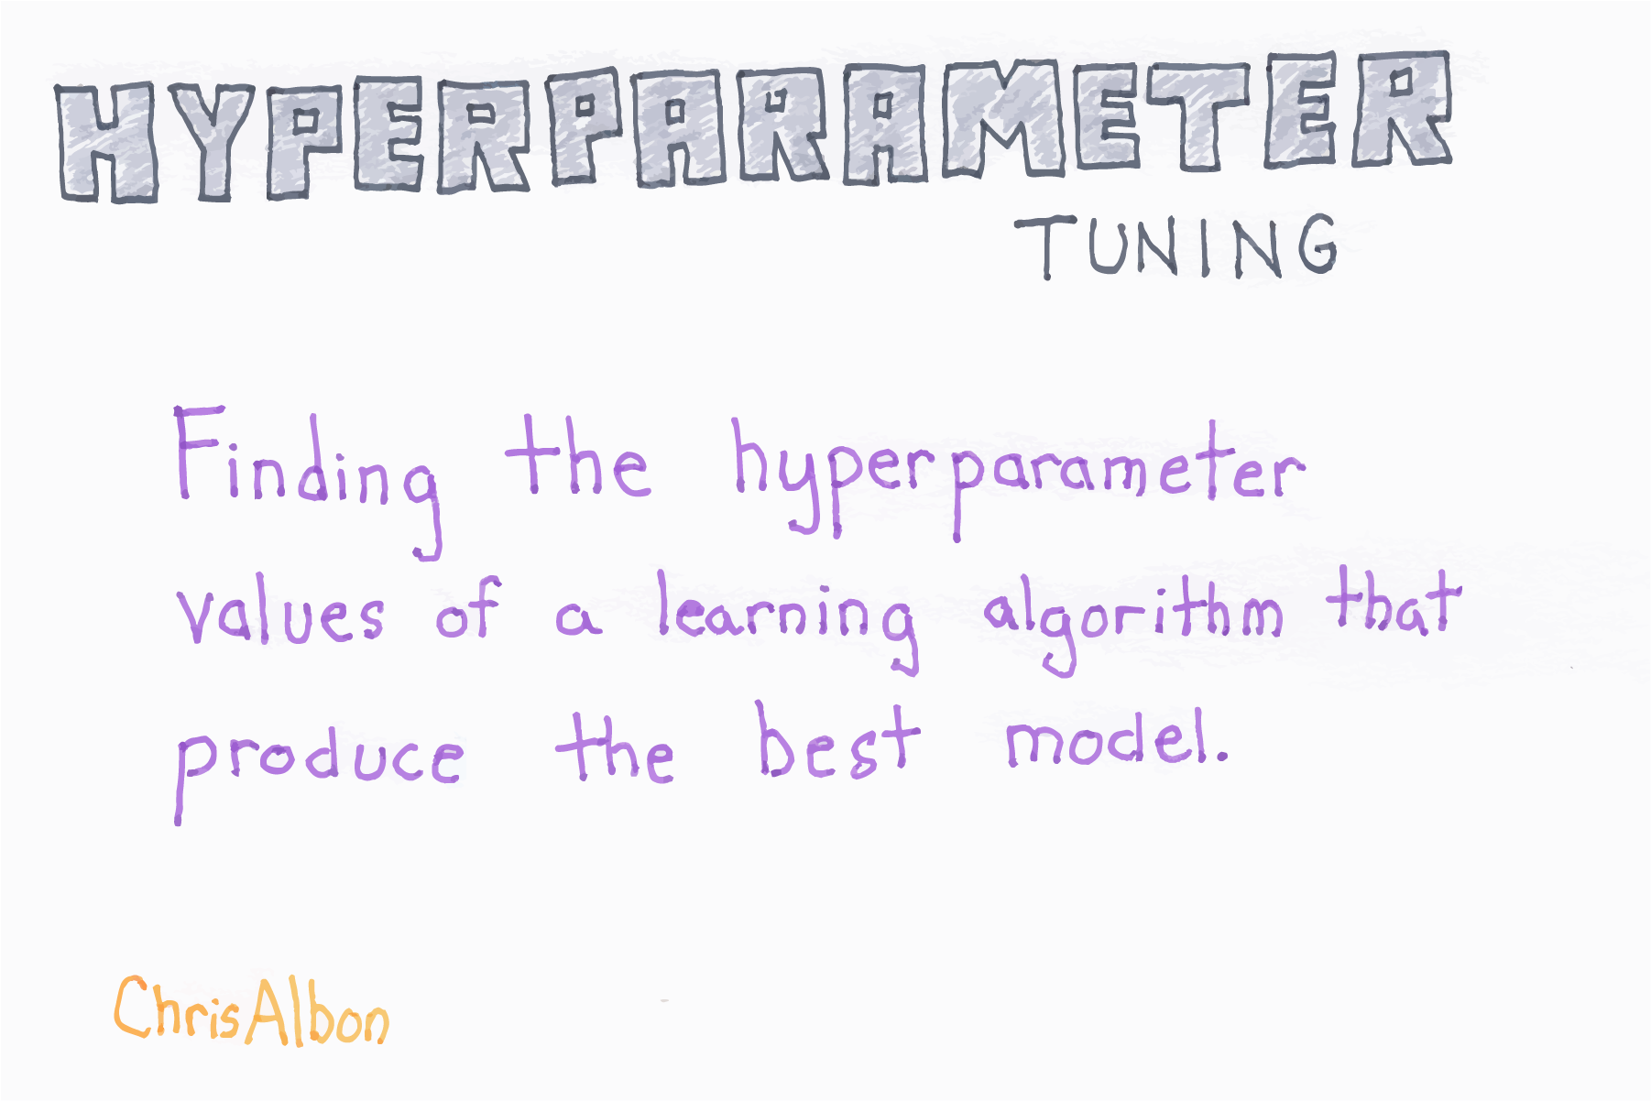
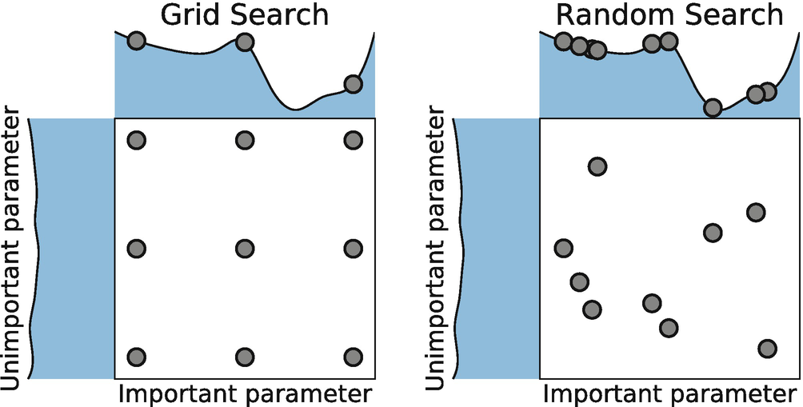

Slide 11
How do I validate my the parameter tuning
K-Fold, For Each Model + Tuning Parameter Experiment
Slice 1
Slice 2
Slice 3
Slice 4
Slice 5
Slice 1
Slice 2
Slice 3
Slice 4
Slice 5
Slice 1
Slice 2
Slice 3
Slice 4
Slice 5
Slice 1
Slice 2
Slice 3
Slice 4
Slice 5
Slice 1
Slice 2
Slice 3
Slice 4
Slice 5
Average the holdout performance over the 5 folds to ensure generalization of parameters

Slide 12
Brue Force Grid Search
GridSearchCV
Grid Search tests all combinations (of hyper parameters) using user specified evaluation metrics such as accuracy, precision, recall, etc.
For example suppose I wanted to tune a Random Forest Model and I want to test combinations of
n_estimators : 10, 20, and 30
max_depth : 10 & 20
min_samples_leaf: 2 & 4
I could setup a three for loops OR I could just specify the tuning parameters that I want to test
param_grid = {
'classifier__n_estimators': [10,20, 30],
'classifier__max_depth': [10,20],
'classifier__min_samples_leaf': [2,4]
}
Notice that weird classifier__ then parameter?
Since our model specification is in a pipeline we need to tell python where the parameters are and what they are for.
https://towardsdatascience.com/l1-and-l2-regularization-methods-ce25e7fc831c

Slide 13
Brue Force Grid Search
GridSearchCV
Grid Search tests all combinations (of hyper parameters) using user specified evaluation metrics such as accuracy, precision, recall, etc.
For example suppose I wanted to tune a Random Forest Model and I want to test combinations of
n_estimators : 10, 20, and 30
max_depth : 10 & 20
min_samples_leaf: 2 & 4
I could setup a three for loops OR I could just specify the tuning parameters that I want to test
param_grid = {
'classifier__n_estimators': [10,20, 30],
'classifier__max_depth’: [10,20],
'classifier__min_samples_leaf': [2,4]
}
Notice that weird classifier__ then parameter?
Since our model specification is in a pipeline we need to tell python where the parameters are and what they are for.
https://towardsdatascience.com/l1-and-l2-regularization-methods-ce25e7fc831c

Slide 14
k-fold cross-validation?
GridSearchCV, RandomizedSearchCV
Cross-validation is a resampling procedure used to evaluate machine learning models on a limited data sample. Here is the basic procedure
Shuffle the dataset randomly.
Split the dataset into k groups
For each unique group:
Take a group as a hold out or test data set
Take the remaining groups as a training data set
Fit a model on the training set and evaluate it on the test set
Retain the evaluation score
Summarize the model using the evaluation scores
Average accuracy over each run.

Slide 15
Tuning Grid
Each row is an experiment
For each Parameter Permutation
n_estimators | max_depth | min_samples_leaf
10 | 10 | 2
20 | 10 | 2
30 | 10 | 2
10 | 20 | 2
20 | 20 | 2
30 | 20 | 2
10 | 10 | 4
20 | 10 | 4
30 | 10 | 4
10 | 20 | 4
20 | 20 | 4
30 | 20 | 4
Fit your model
K-times,
Average results
on hold out
param_grid = {
'classifier__n_estimators': [10,20, 30],
'classifier__max_depth’: [10,20],
'classifier__min_samples_leaf': [2,4]
}
3 * 2 * 2

Slide 16
How to…
Basic Sugar Cookie Recipe
Define your pipeline
Pick your parameters and throw them into a dictionary
This determines the number of possible candidates to test
Configure the CV strategy
This defines which candidates and number of folds to test on.
For each candidate there are k-folds fits so 3 tests * 5 folds = 15 fits
Brute Force (GridSearchCV) or Random Search (RandomsearchCV)
Scoring = “roc_auc”
Refit = “roc_auc”
N_jobs = -1
Pick a Scoring Metric to “optimize”
Classification = “roc_auc” and accuracy but also logloss and others
Fit the Search to kick it off, in parallel
Evaluate the runs
Select best fit model

Slide 17
1. Define your Pipeline
categorical_pipe = Pipeline([
('imputer', SimpleImputer(strategy='constant', fill_value='missing')),
('trgenc', TargetEncoder())
])
numerical_pipe = Pipeline([
('imputer', SimpleImputer(strategy='mean'))
])
preprocessing = ColumnTransformer(transformers=[
('cat', categorical_pipe, categorical_features),
('num', numerical_pipe, numeric_features)
])
model_pipeline = Pipeline([
('preprocess', preprocessing),
('classifier', GradientBoostingClassifier())
])

Slide 18
2. Pick Parameters
Candidate tests
You can get a list of the parameter hooks from your_pipeline.get_params().keys()
param_grid = {
'classifier__learning_rate':[0.001, 0.01, 0.1],
'classifier__n_estimators': [100,125, 150, 175, 200],
'classifier__max_depth': [15,20,25],
'classifier__min_samples_leaf': [2,4]
}
classifier__ccp_alpha
classifier__criterion
classifier__init
classifier__learning_rate
classifier__loss
classifier__max_depth
classifier__max_features
classifier__max_leaf_nodes
classifier__min_impurity_decrease
classifier__min_impurity_split
Notice that weird classifier__ then parameter?
Since our model specification is in a pipeline we need to tell python where the parameters are and what they are for.

Slide 19
3. Configure the HPO/ CV strategy
RandomizedSearchCV, GridSearchCV
RandomizedSearchCV
estimator = model_pipeline,
param_distributions = param_grid, dictionary of parameters
n_iter = defaults to 10 random, trade off between runtime vs quality of the solution
Not available GridSearchCV
n_jobs=-1, launch on all available cores
verbose=3, controls the amount of messages spit out
cv=5, number of folds 5 and 10 are common
scoring="roc_auc", evaluates the predictions on the test set.
refit = True - Refit an estimator using the best found parameters on the whole dataset.

Slide 20
4. Fit in Parallel
Be prepared to wait… and if you run out of memory try pre_dispatch =2
gbm_model = RandomizedSearchCV(model_pipeline, param_grid, n_iter= 3, n_jobs=-1, verbose=3, cv=5, scoring="roc_auc", refit=True)
hpo_search = gbm_model.fit(train[numeric_features + categorical_features], train[target])
Fitting 5 folds for each of 3 candidates, totalling 15 fits
[Parallel(n_jobs=-1)]: Using backend LokyBackend with 4 concurrent workers.
[Parallel(n_jobs=-1)]: Done 15 out of 15 | elapsed: 42.8s finished

Slide 21
Cross Fold Results
pd.DataFrame(hpo_search.cv_results_)
Test # | mean_fit_time | std_fit_time | mean_score_time | std_score_time | param_classifier__min_samples_leaf | param_classifier__max_depth | param_classifier__learning_rate | params | split0_test_score | split1_test_score | split2_test_score | split3_test_score | split4_test_score | mean_test_score | std_test_score | rank_test_score
2 | 43.4247 | 1.1899 | 0.2504 | 0.0477 | 4 | 15 | 0.1 | {'classifier__min_samples_leaf': 4, 'classifier__max_depth': 15, 'classifier__learning_rate': 0.1} | 0.91668923 | 0.92135369 | 0.91050442 | 0.92029675 | 0.91851456 | 0.91747173 | 0.00382867 | 1
0 | 43.9367 | 1.5057 | 0.2868 | 0.0673 | 2 | 15 | 0.1 | {'classifier__min_samples_leaf': 2, 'classifier__max_depth': 15, 'classifier__learning_rate': 0.1} | 0.91466667 | 0.91938987 | 0.90787039 | 0.91573131 | 0.91643116 | 0.91481788 | 0.00381131 | 2
7 | 29.1481 | 3.8900 | 0.1568 | 0.0239 | 4 | 10 | 0.01 | {'classifier__min_samples_leaf': 4, 'classifier__max_depth': 10, 'classifier__learning_rate': 0.01} | 0.91318778 | 0.9183384 | 0.90568272 | 0.91576206 | 0.91467884 | 0.91352996 | 0.00426895 | 3
8 | 61.4381 | 7.4244 | 0.2238 | 0.0324 | 2 | 20 | 0.1 | {'classifier__min_samples_leaf': 2, 'classifier__max_depth': 20, 'classifier__learning_rate': 0.1} | 0.90945695 | 0.91468501 | 0.90360377 | 0.91090191 | 0.91056505 | 0.90984254 | 0.00358231 | 4
https://medium.com/@moritzkoerber/tune-your-preprocessing-steps-and-algorithm-selection-like-hyperparameters-c817e6572335

Slide 22
Cross Fold Results
cv_results_ - A dict with keys as column headers and values as columns, that can be imported into a pandas DataFrame. pd.DataFrame(hpo_search.cv_results_)
You can convert this to a dataframe and plot it
see the details from each fold
See the best parameters
best_estimator_ - Estimator that was chosen by the search, i.e. estimator which gave highest score (or smallest loss if specified) on the left out data.
Not available if refit=False.
best_params_ - Parameter setting that gave the best results on the hold out data.

Slide 23


